Slide 1
Stock Market Analysis (Amazon)
Team Members
Dandu Sumathi
Ganta Pravallika
M Aravind
Align Elsa Agith
Atharva Abitkar
Sayed Mukeeth

Slide 2

Intoduction
This project focuses on analyzing Amazon's stock market performance to understand its price trends and patterns. By utilizing various data analysis techniques, including moving averages and visualizations, the project aims to provide insights into Amazon's stock behavior over time, helping investors make informed decisions. The analysis includes evaluating historical price data, identifying trends, and using statistical tools to predict future stock movements.

Slide 3

Problem Statement
"In a highly volatile stock market environment, investors often struggle to make informed decisions due to the vast amount of data and unpredictable trends. This project aims to analyze historical stock data of Amazon using advanced techniques like Exploratory Data Analysis (EDA), ARIMA, FBProphet, and Recurrent Neural Networks (RNN) to identify patterns and predict future stock prices. By providing accurate predictions and actionable insights, the project seeks to help investors optimize their trading strategies and reduce risk."

Slide 4

Data Summary
Amazon Stock Market Analysis Data Summary
Data Source: 1,0006 rows, 6 columns (‘Open’ , ‘Close’ , ‘Low’ , ‘High’ , ‘Adj close’ , ‘Volume’)
Data Preparation: 1) Cleaned and normalized data for analysis
2) Handled missing values with rolling means
Visualization: Line Charts, Moving averages, histograms, and scatter plots to explore trends
Modeling Techniques: Forecasting with FBProphet , ARIMA, and LSTM models to predict future stock price.
This Photo by Unknown Author is licensed under CC BY-NC-ND

Slide 5
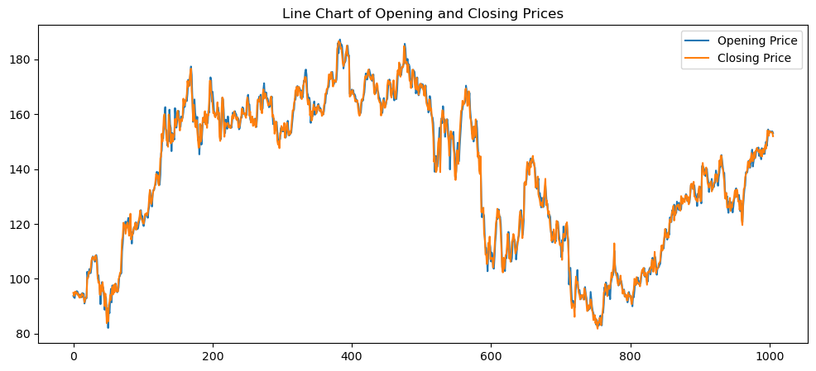
EDA Part
Line Chart - Plotting the Opening Price and Closing Price

Slide 6
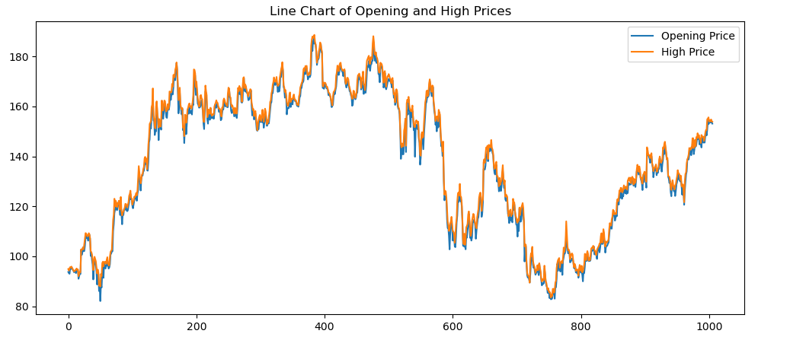
Line Chart - Plotting the Opening Price and High Price

Slide 7
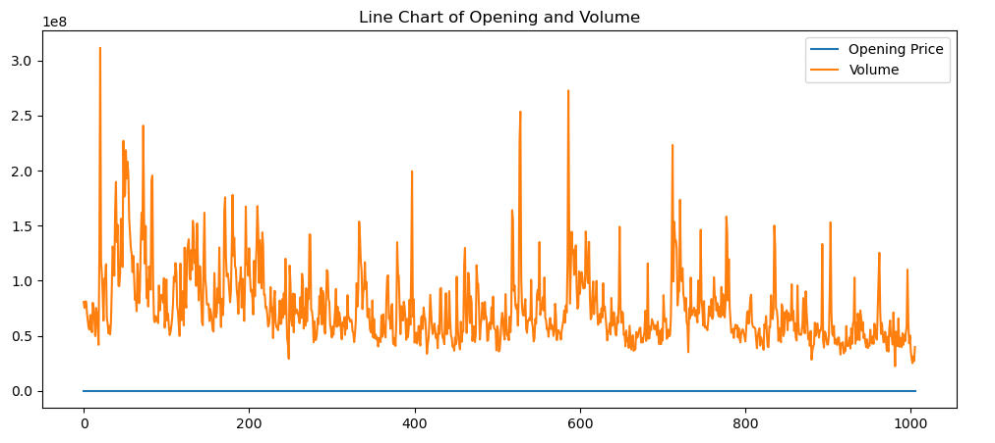
Line Chart - Plotting the Opening Price and Volume

Slide 8
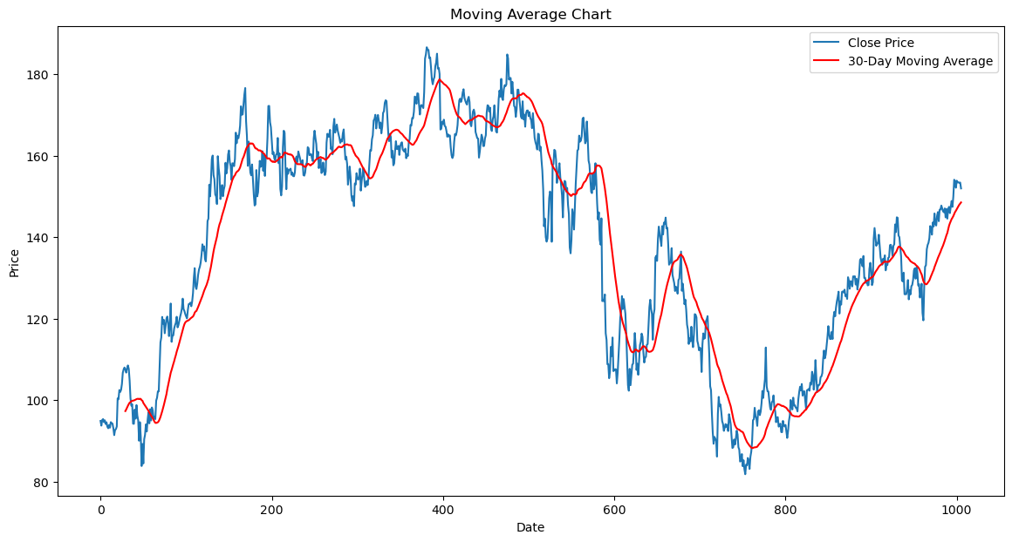
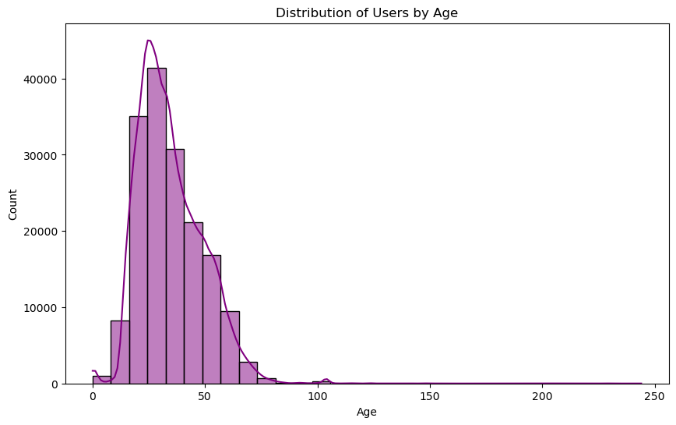
Moving Average Chart : This plot shows the closing prices along with a 30-day moving average.
Moving Average Chart - 30 Day Moving Average

Slide 9
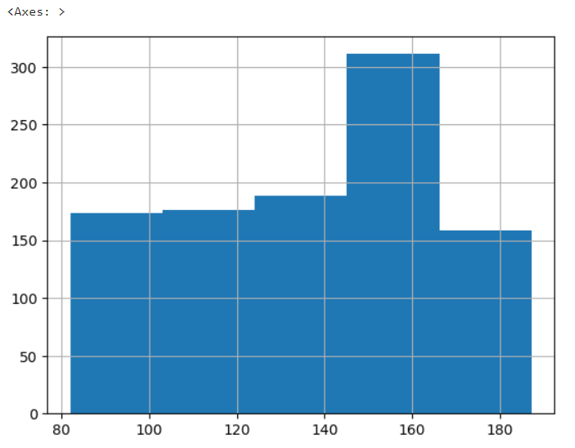
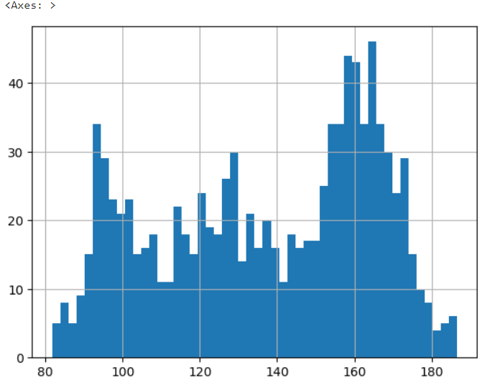
Displaying Open & Closing Sales with Histogram

Slide 10
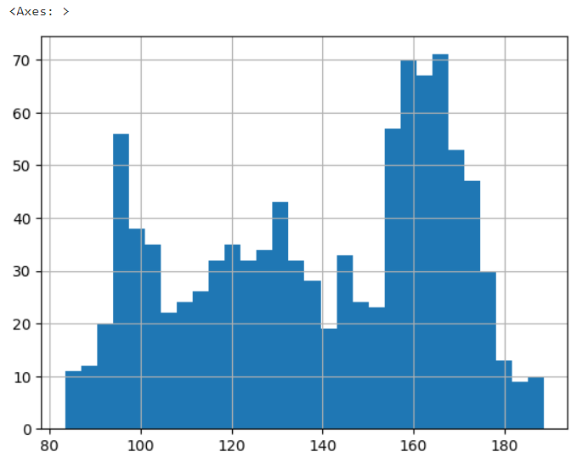
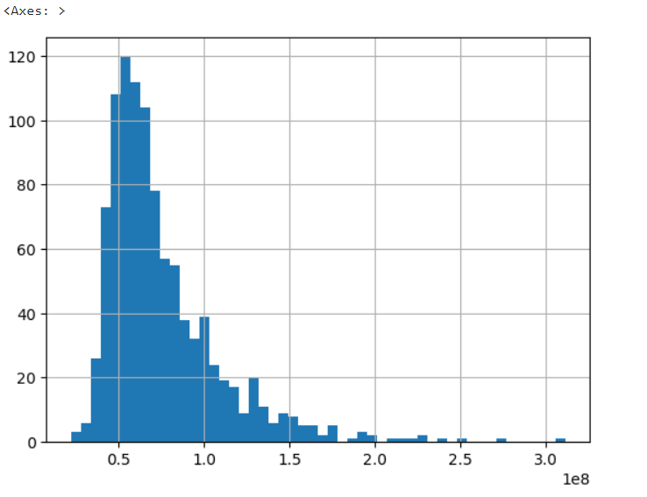
Displaying High & Volume with Histogram

Slide 11
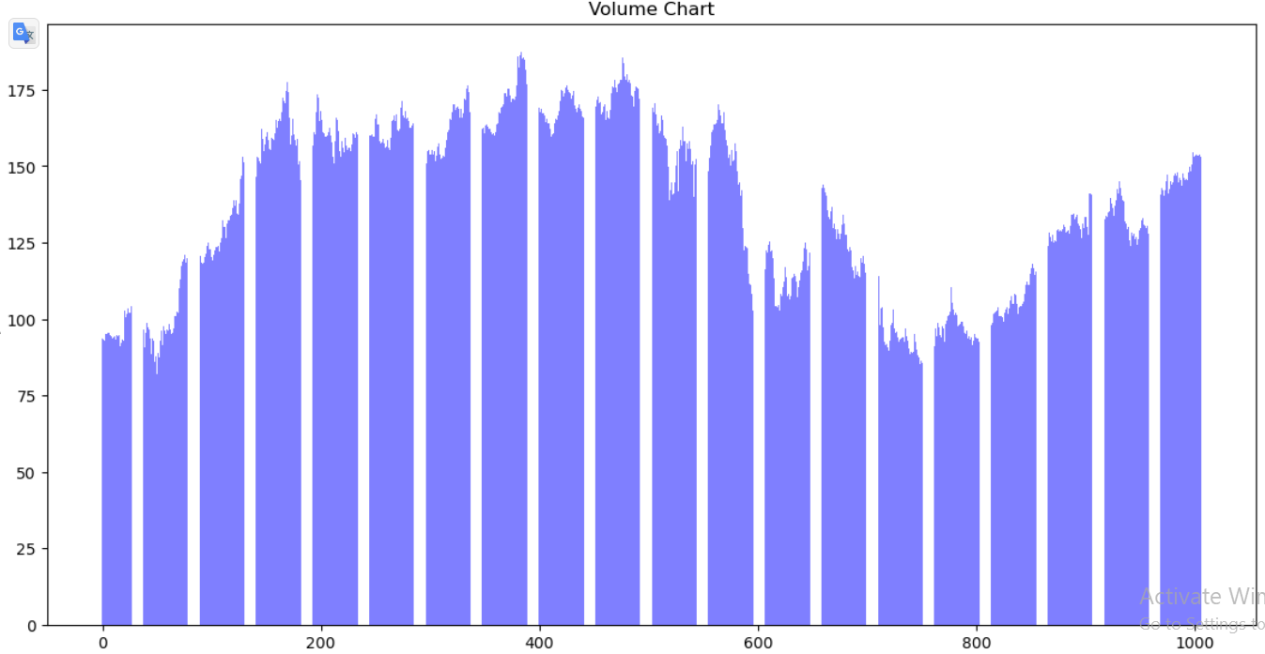
Volume Chart - Separate Volume Plot for Open

Slide 12
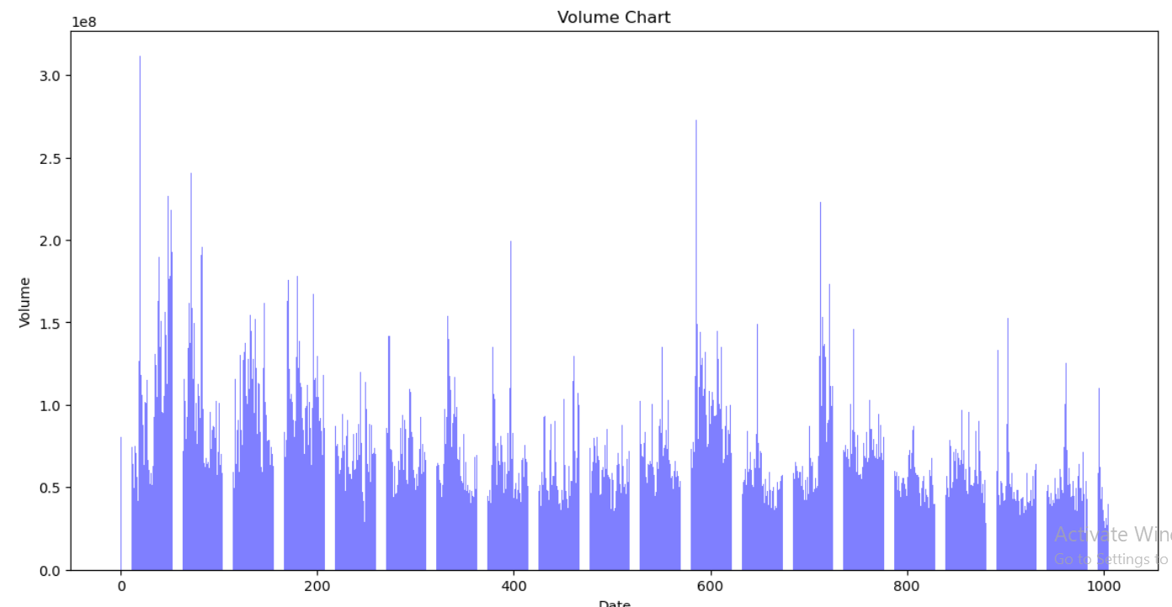
Volume Chart - Separate Volume Plot

Slide 13
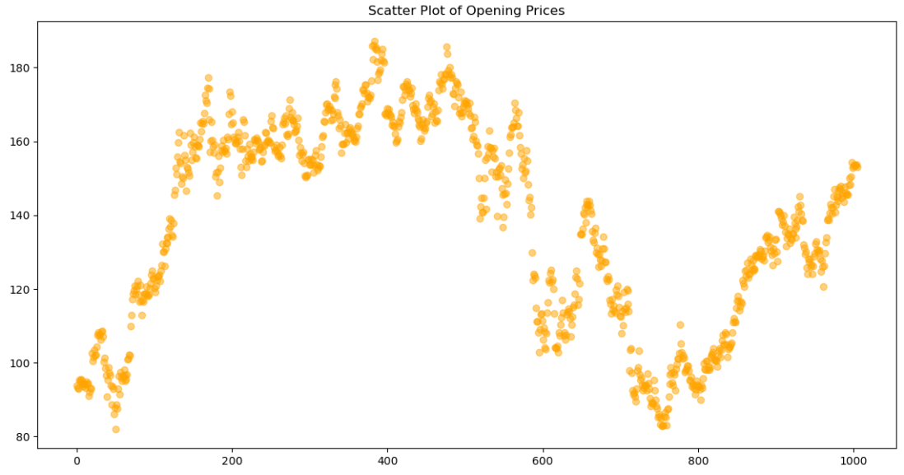
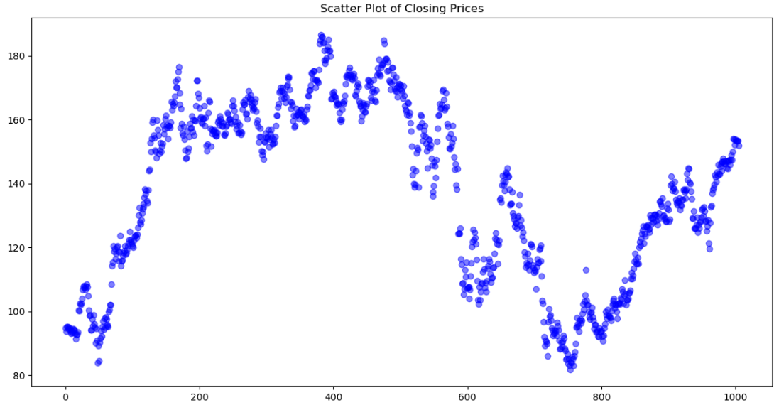
Scatter Plots for Opening and Closing Prices :

Slide 14
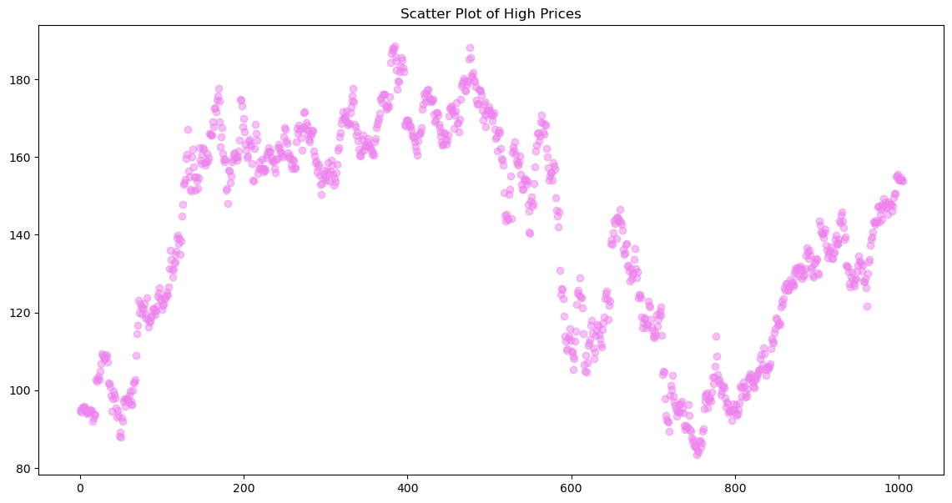
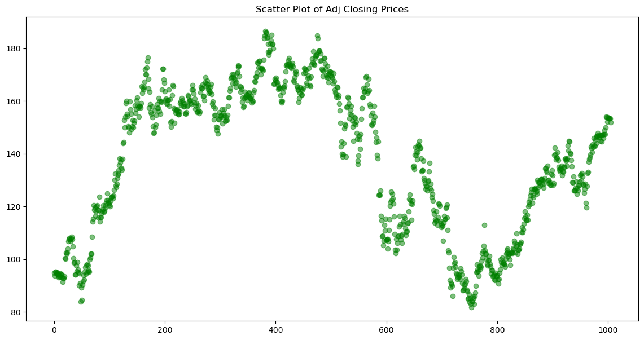
Scatter Plots for High and Closing prices

Slide 15
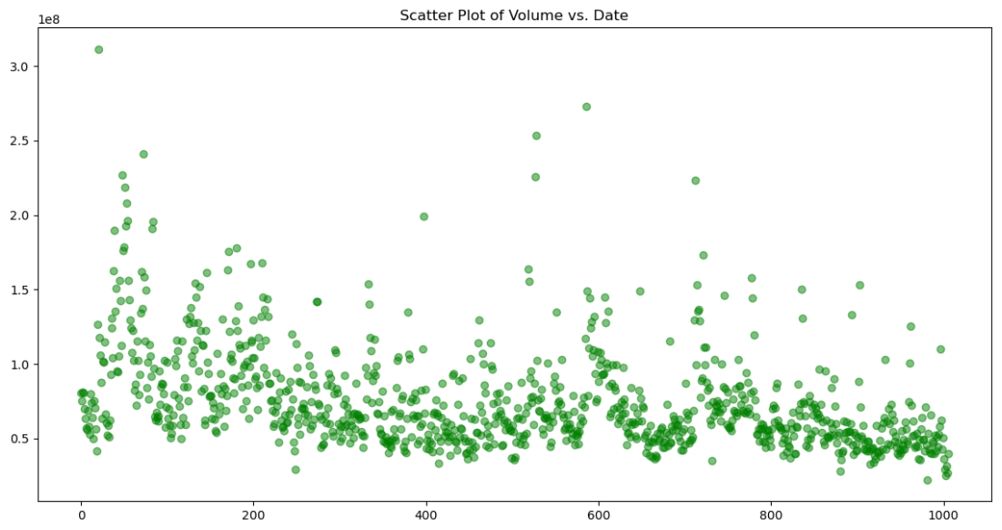
Scatter Plot for Volume and Data

Slide 16

Model Building: Model Building Using FBProphet : FBProphet is a forecasting time series data, based on an additive model where non-linear trends are fit with yearly, weekly, and daily seasonality, plus holiday effects. It works best with time series that have strong seasonal effects and several seasons of historical data.
This Photo by Unknown Author is licensed under CC BY

Slide 17
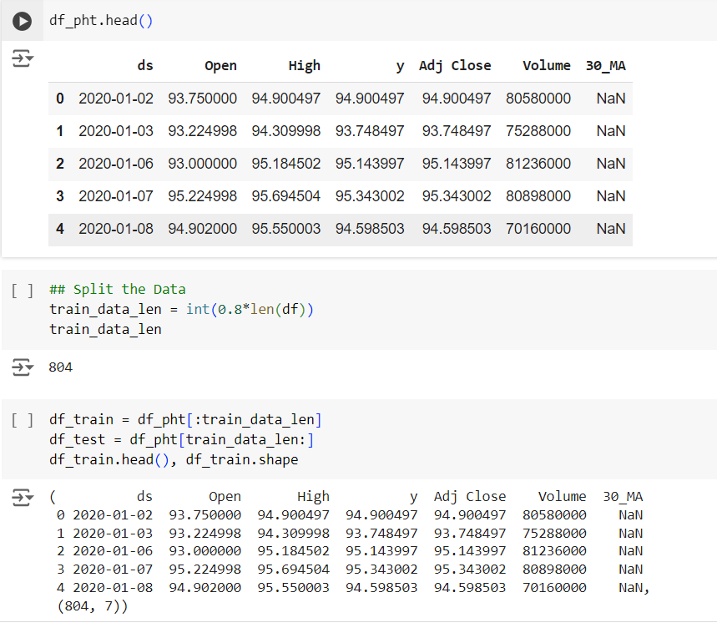
Data Preview: The first few rows of the dataset (df_pht.head()) display columns like date (ds), opening price (Open), highest price (High), target value (y), adjusted closing price (Adj Close), trading volume (Volume), and a 30-day moving average (30_MA). The 30_MA column initially shows NaN values, indicating it hasn't been calculated for the early rows.
Data Splitting: The dataset is split into training and testing sets. The training set (df_train) contains 80% of the data (train_data_len is 804), while the remaining 20% is reserved for testing. The shape of the training data is also shown, containing 804 rows and 7 columns.
Splitting the Data

Slide 18
Fit The Model
Importing the prophet library Creating a Prophet model and fitting it to a training dataset. Calculating the number of periods to forecast. Creating a DataFrame with future dates using the Prophet model. Printing the shape of the future DataFrame
Making Predictions
#yhat : the predicted forecast
#yhat_lower : the lower border of the prediction
#yhat_upper: the upper border of the prediction

Slide 19
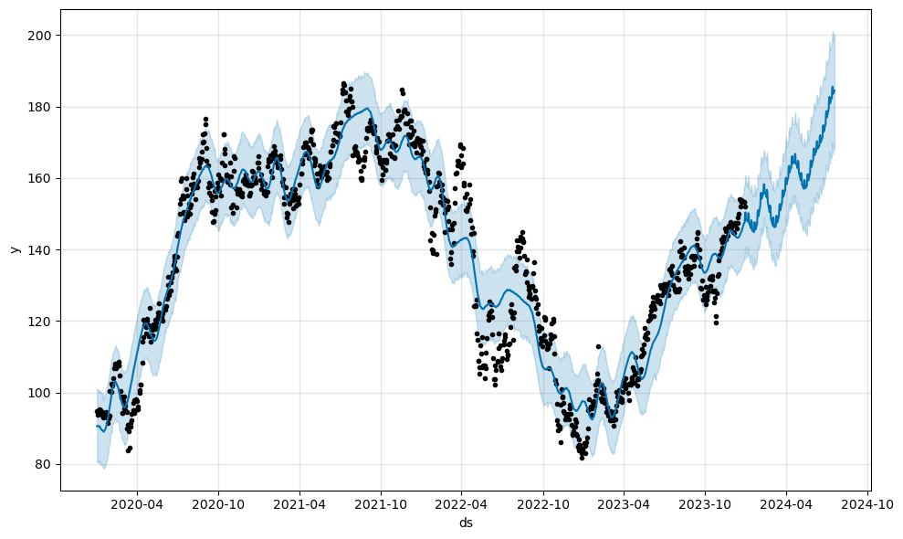
Plotting Predictions
#Trending data
#Black dots : the actual data points in our dataset.
#Deep blue line : the predicted forecast/the predicted values
#Light blue line : the boundaries

Slide 20
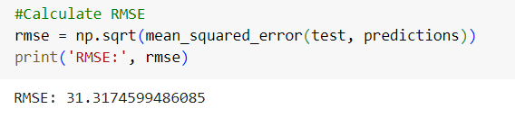
ARIMA Model for Time Series Prediction Using a trained Prophet model to make prediction for future values Evaluating the accuracy of the predictions using RMSE metric The output RMSE: 31.3174599486085 indicates that the RMSE between the predicted values and the actual test values is approximately 31.32. This value can be interpreted as the average error between the predictions and the true values. A lower RMSE generally indicates better model performance.

Slide 21
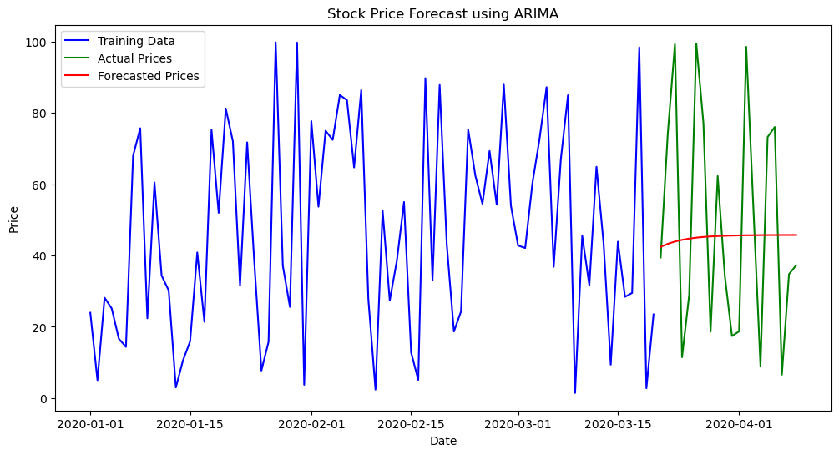
ARIMA Model Results

Slide 22
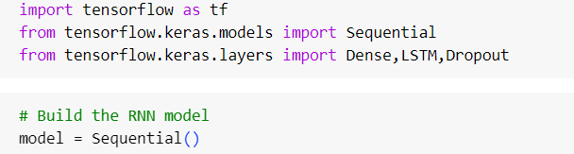
LSTM based RNN using Tensorflow Effective for modeling sequential data. Address the vanishing gradient problem. Use memory cells to capture long-term dependencies. Widely used in NLP, time series forecasting, and more. Implemented in TensorFlow using the keras.Sequential API.

Slide 23
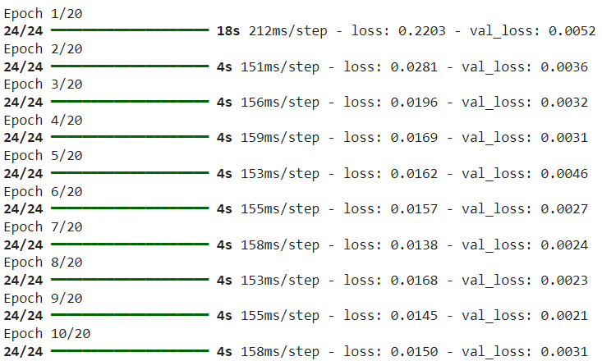
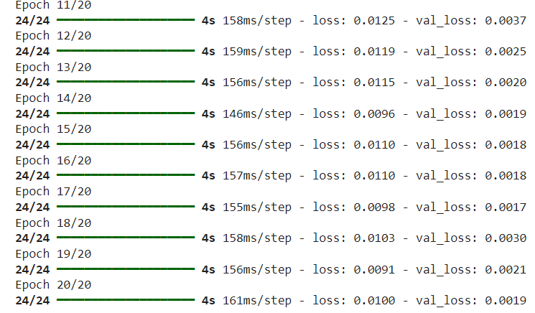
RESULT OF Trained Model

Slide 24
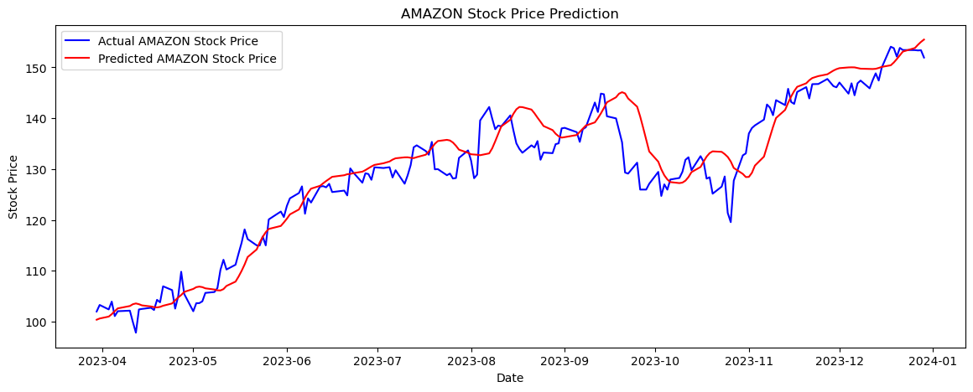
Prediction Result

Slide 25
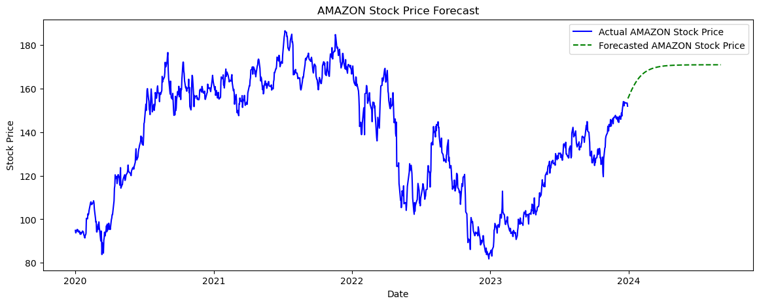

Slide 26
Conclusion
Insights Gained: Successfully analyzed Amazon stock data, identifying key trends and patterns from 2020 to 2024.
Model Performance: Utilized FBProphet, ARIMA, and LSTM models to forecast stock prices, achieving accurate predictions and understanding market behavior.
Value for Investors: Provided data-driven insights and predictive analytics to help investors make informed decisions and optimize their trading strategies.

Slide 27
Future Scope
Enhanced Models: Incorporate additional machine learning algorithms or advanced models like LSTM (Long Short-Term Memory) or Transformer models for better prediction accuracy.
Real-time Data: Implement real-time data streaming for live predictions and analysis.
Broader Data Set: Extend the analysis to include more stocks, indices, or global markets.
Integration: Integrate with trading platforms for automated trading strategies based on predictions.
User Interface: Enhance the Streamlit dashboard with more interactive features and data visualization options.
Sentiment Analysis: Combine stock data with sentiment analysis from news or social media for more comprehensive predictions.

Slide 28
THANK YOU !

